Slide 1

Course Portfolio for Fall 2024
Katherine Stanton
ITAI1378 – Computer Vision
December 11, 2024
GitHUb Repository:
https://github.com/ktgraze/Course-Portfolio-Final-ITAI1378.git

Slide 2
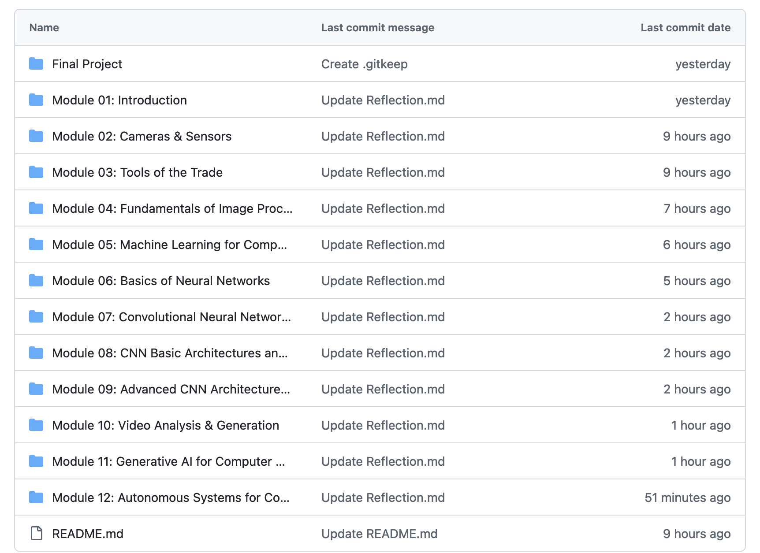
• This portfolio is intended to showcase everything I learned in this course, the skills I built upon, and my contributions to group projects throughout the semester. My GitHub repository is organized by module, with each of the 12 modules assigned its own folder, which contains a file each for all module group assignments, individual labs, and a reflection.
• Key modules that I feel have made a lasting impression include Module 04 – on the fundamentals of Image Processing, Module 06, an introduction to Basic Neural Networks, and Module 07, which covers Convolutional Neural Networks, with the accompanying group assignment that called for us to create a Manual CNN.
• Summary of skills and tools learned (e.g., Python, GitHub, AI concepts).
Screenshot of my GitHub repository structure.

Slide 3
Slide 3: Key Highlights
Content:
• Highlight 2-3 significant modules or projects.
• Include brief descriptions of key activities or labs.
• Use visuals like graphs, images, or code snippets to illustrate your work.
• Mention one major takeaway or skill gained from each highlighted module/project.

Slide 4
Slide 4: Reflections and Resources
Content:
• Your personal insights and growth throughout the course.
• Challenges faced and how you overcame them.
• Highlight 2-3 key articles, videos, or external resources that influenced your learning.
• Add brief explanations of their relevance and include links.

Slide 5
Content:
• Summary of your learning journey and overall experience.
• How you plan to use these skills in future projects, internships, or jobs.
• Thank you note and GitHub repository link (include as a QR code for easy access).
• Optional: Inspirational quote or image to close the presentation.

